Slide 1

Black-White gap in skills, employment and experience-wage profiles
Maksym Kutsenko

Slide 2
Outline
Introduction and motivations behind the study
Gap in wages and skills, some observations, some studies and their limitations
College Premium over the life-cycle
Goal of the paper
Data
Methodology
Empirical Model
Results
Baseline and functional form adjusted
Robustness Check
Additional cool result

Slide 3
What I am seeking help on
How do I frame this paper?
It is not a causal paper, but it is not a purely descriptive one neither
The closest I can think of in terms of type (not in terms of quality and depth of course) are Raj Chetty’s papers on IG mobility
Methodological approval
It is a quantile regression framework applied to a panel setting, and literature was scarce and hard

Slide 4
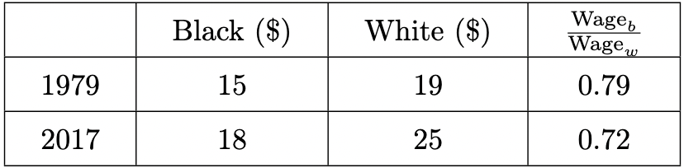
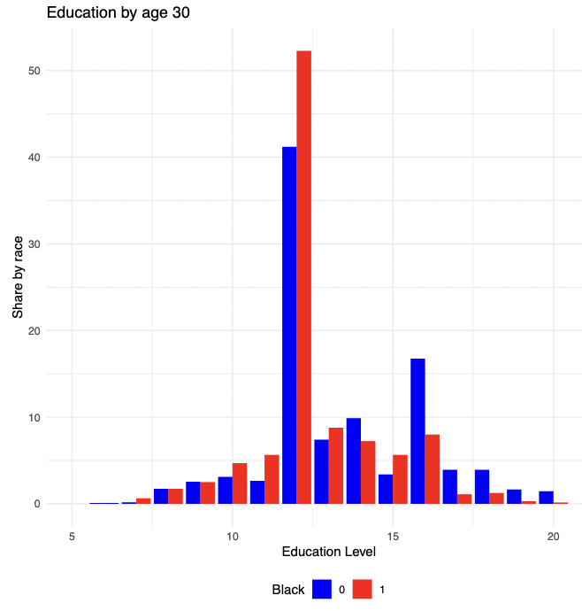
Motivation
Gaps:
In mean wages…
But also in education and skills
Debate: Skills vs discrimination
Issues with usual studies:
Reverse causality, OVB, etc.
But also main focus on the gap at a given point in time.
Resulting question: How do wages evolve over the life cycle before and after accounting for the gap in education and skills?

Slide 5
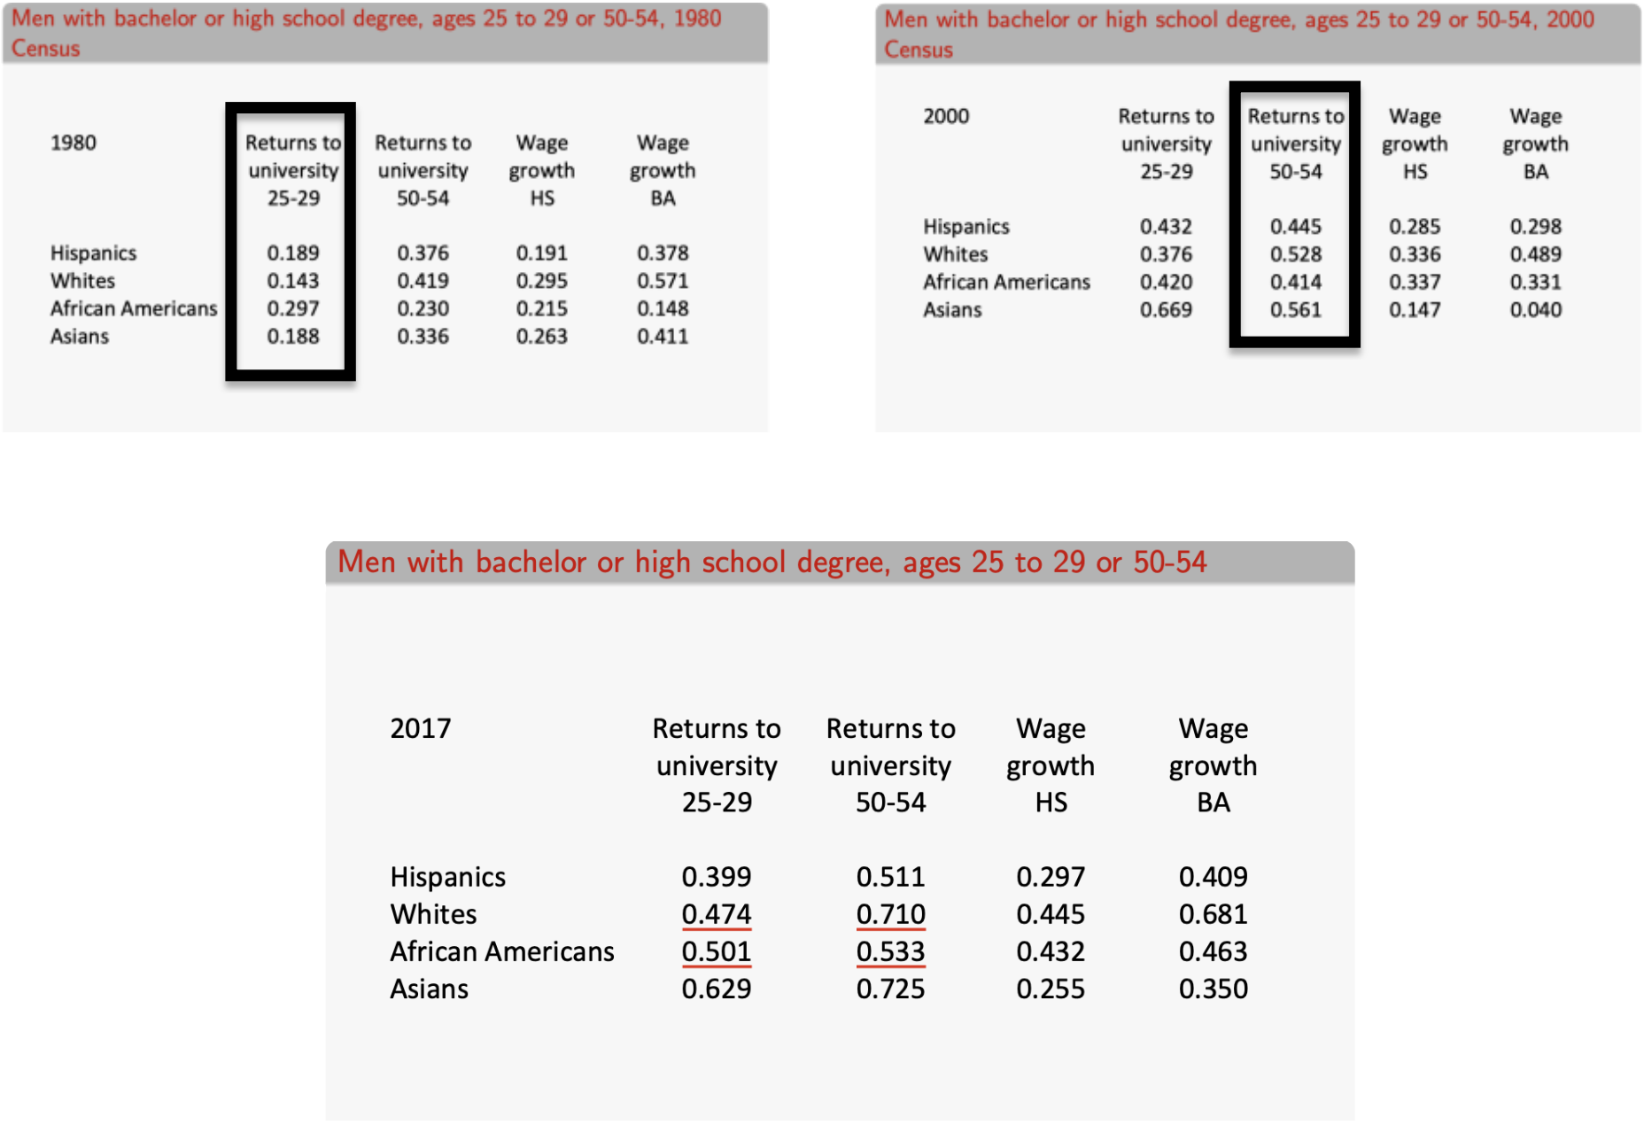
Do we really care about it? College premium for Blacks and Whites (Descriptive)
Blacks get a higher college premium when 25 – 29
However, this premium is smaller when they are 50-54
For Whites, the college premium grows by 39pp
For Blacks, it grows by 12pp (3 times less)
Limitations: Not temporally detailed enough, and does not account for any gap in skills

Slide 6
Research question, Data and Empirical Challenge
Question: Does the wage gap between black and white high school graduates widen over the life-cycle once one accounts for a measure of pre-market cognitive skills?
Data: National Longitudinal Survey of Youth 1979
Follows 12686 individuals from 1979 to 2020 (without accounting for attrition)
Contains information on wages, demographic characteristics, and a measure of cognitive skills
Armed Forces Qualification Test (AFQT), used in Neal and Johnson (1996) and the vast majority of subsequent papers
Empirical Challenge:
High rates of unemployment, and thus estimating whether the wage gap at a point in time is already possibly biased
Solution: Use quantile analysis assigning wages of those unemployed to 0

Slide 7
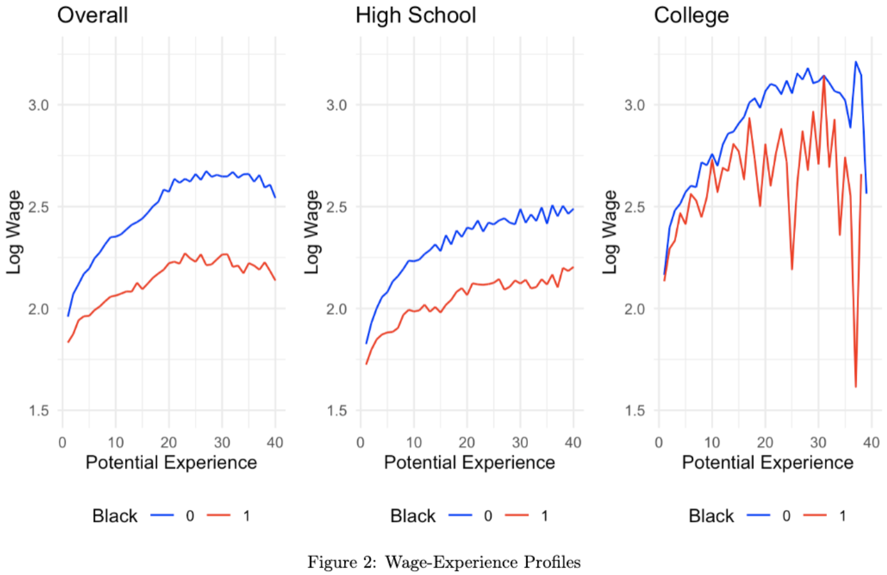
Raw Wage Gap over the life-cycle
There is a widening of the gap in mean wages over the life-cycle
Overall it widens faster than for High School and College only subsets
There are too few Black College students, thus focus on High School students
The gap widens early, and then increases roughly linearly
Neither a linear nor a quadratic specification will perfectly approximate these curves

Slide 8
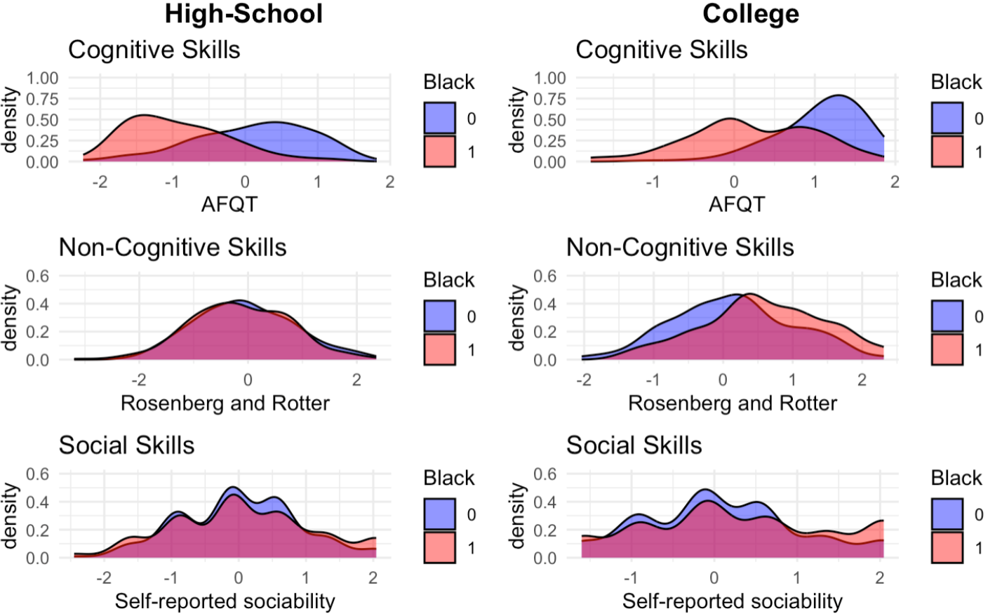
Gap in Skills
Cognitive skills: standardized AFQT scores
Non-cognitive skills: Rosenberg self-esteem scale and Rotter Locus of Control
Social skills: an average of 4 questions (2 self reported, 2 high school clubs)
Evidence of gap in cognitive skills, but nothing for the other two
Notes:
Why does self esteem matter? Mathematically I would formulate it as: If I have higher self esteem, I perceive myself as more capable for a given level of skills, which increases the perceived expected value of my effort, leading to higher effort. Conversely, if my self esteem is low, I will feel like even if I try I will fail, and then stay stuck for a while. A similar line of reasoning + Proactivity applies to the Rotter Locus of control

Slide 9
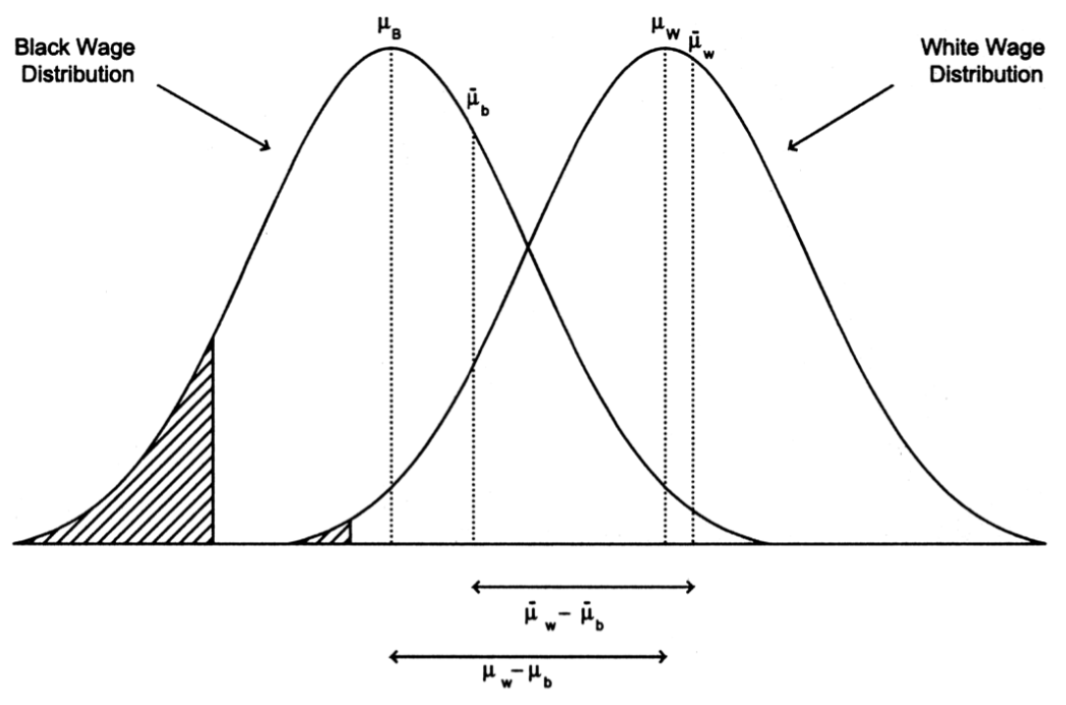
Picturing the Empirical Challenge
If there is a gap in employment, and it is at the bottom of the potential wage distribution
Then the gap in mean observed wages is smaller than the gap in the potential wages is everyone worked

Slide 10
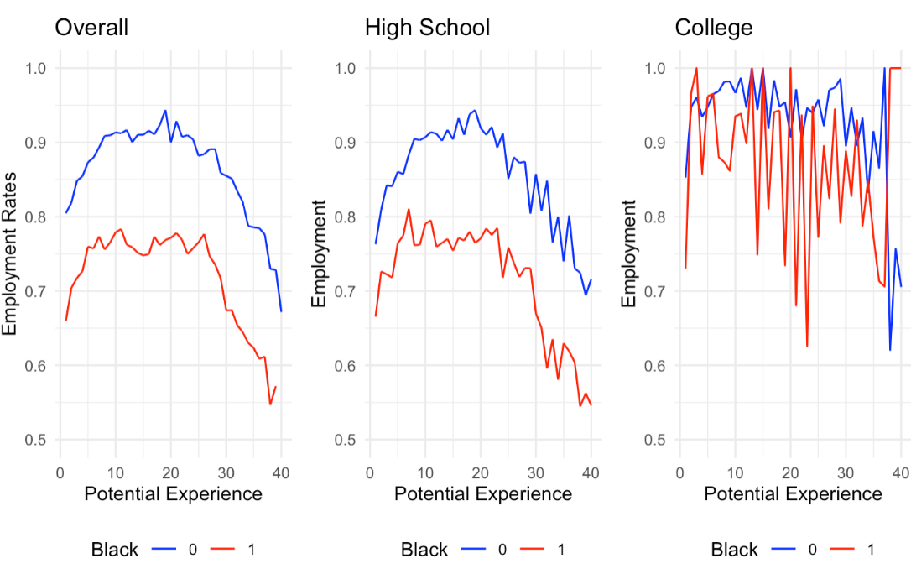
And I do see this issue in the data

Slide 11
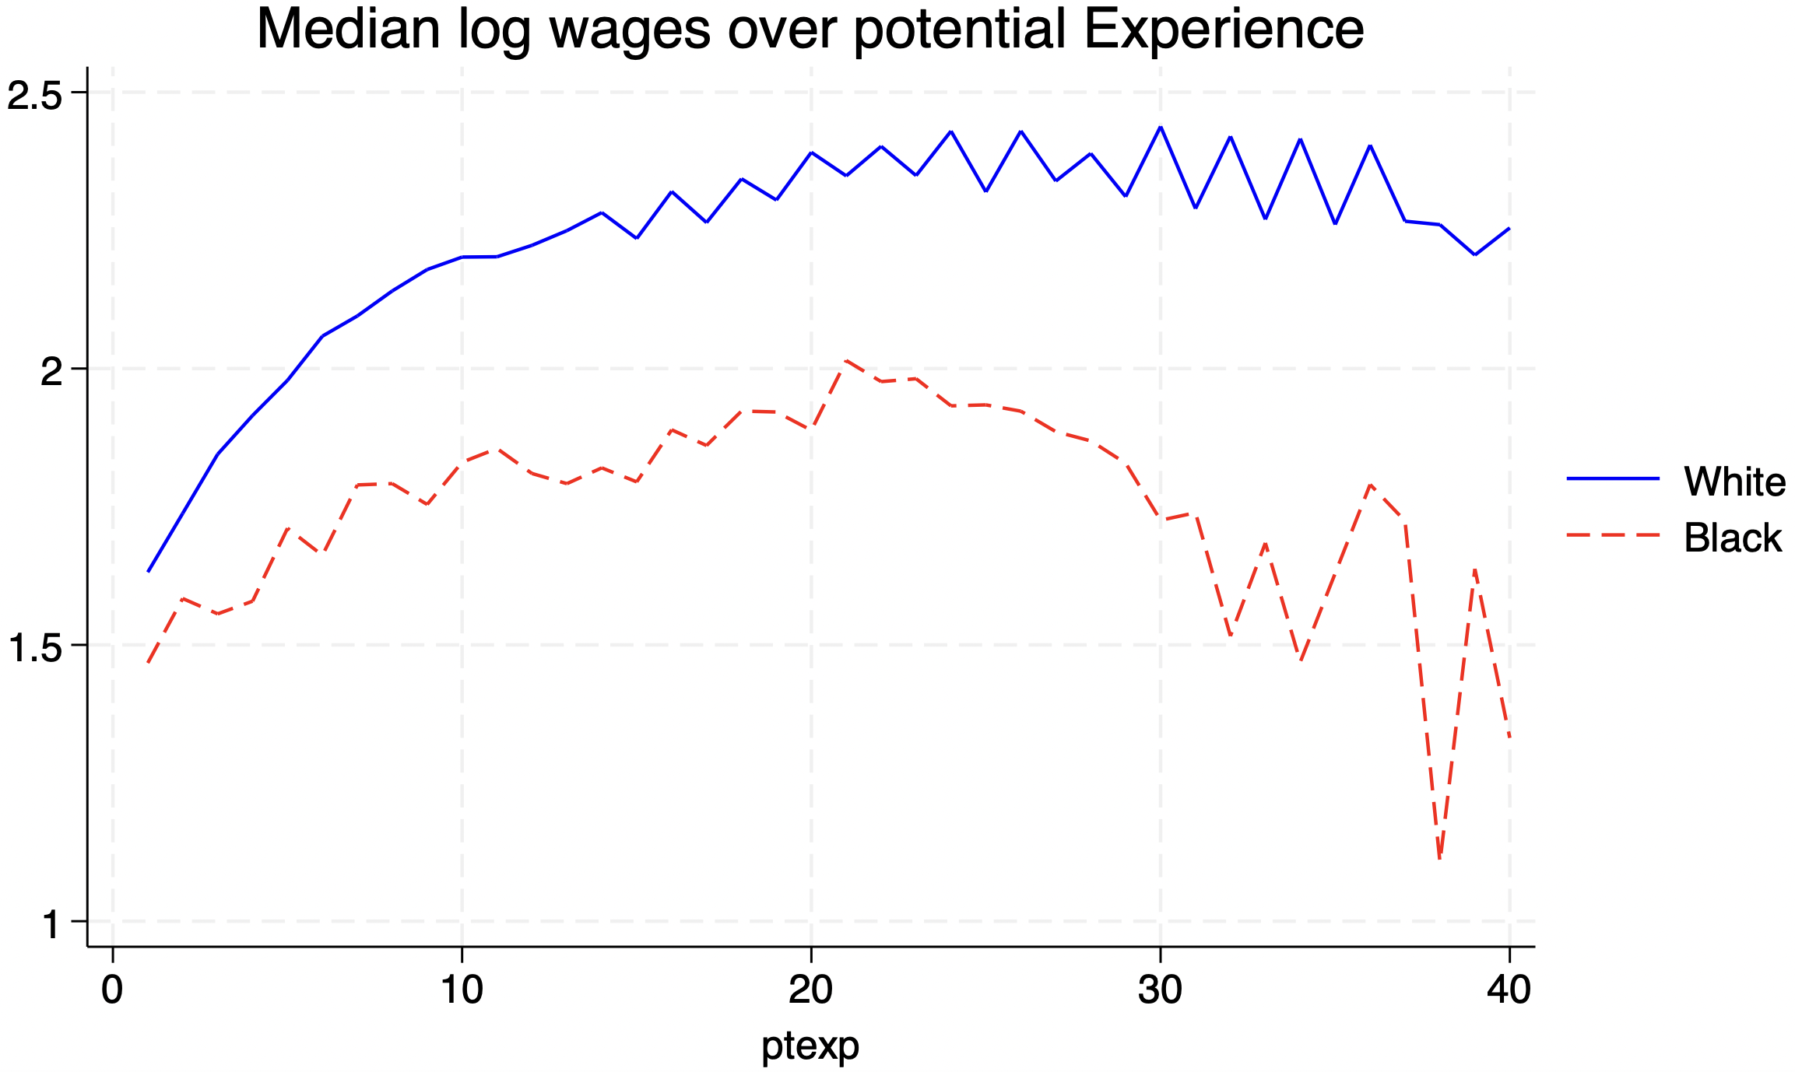
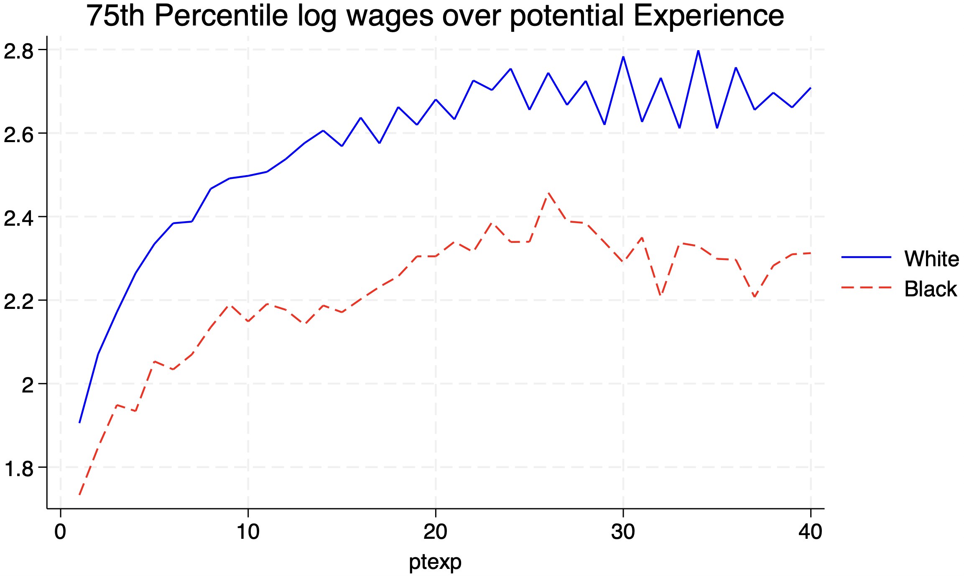
Median and 75th percentile age-wage profiles

Slide 12
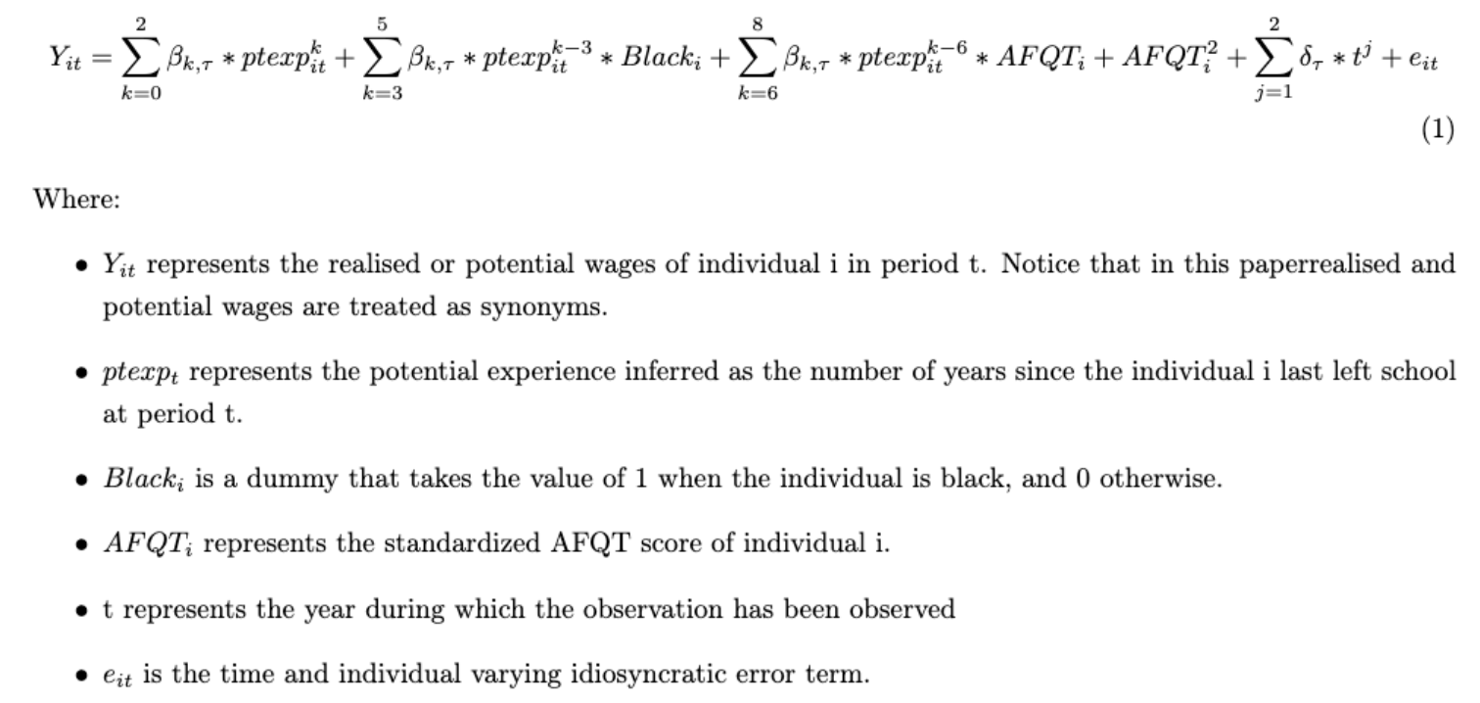
The Model

Slide 13
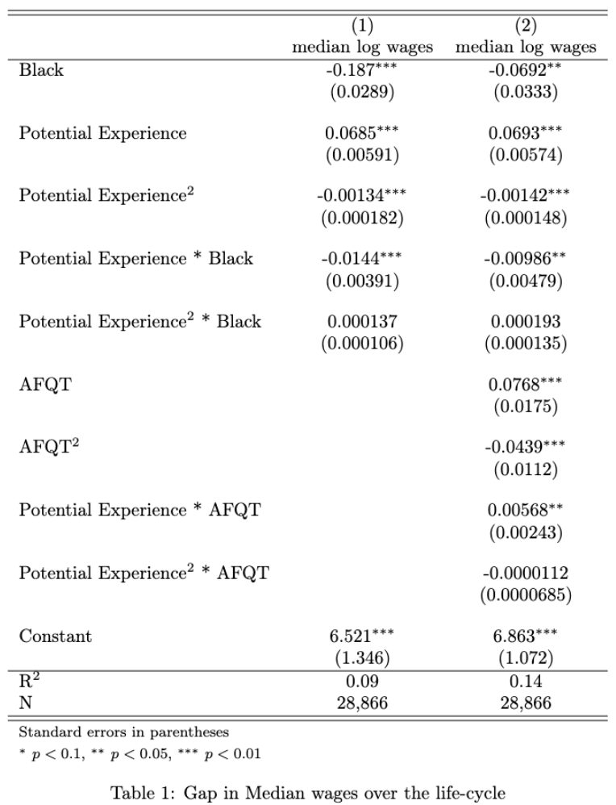
Baseline results
Gap at labor market entry of 18.7%
Gap widens by ~ 1.4%/year in the first years and keeps widening throughout the entire life-cycle
Controlling for AFQT reduces the gap to 6.9% upon labor market entry
AFQT affects the level and trajectory of wages over the life-cycle
The gap widening shrinks by a third, wage gap increases by roughly 1%/year in the first years
Issue: Specification is likely not optimal

Slide 14
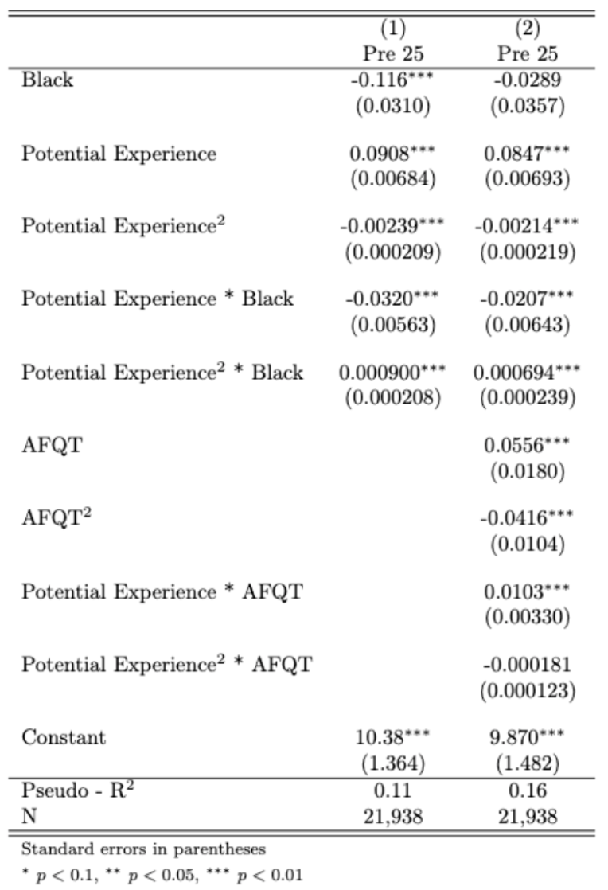
Preferred specification
Subsample of individuals with <=25 years of potential experience
As expected (explained in the paper), the intercept shrinks, and the coefficients on the potential experience coefficients increase in magnitude
AFQT affects age-wage profiles in this setting twice as much as in the previous one.
The raw black-white wage gap widens by roughly 3%/year in the first years, and 2%/year after controlling for AFQT

Slide 15
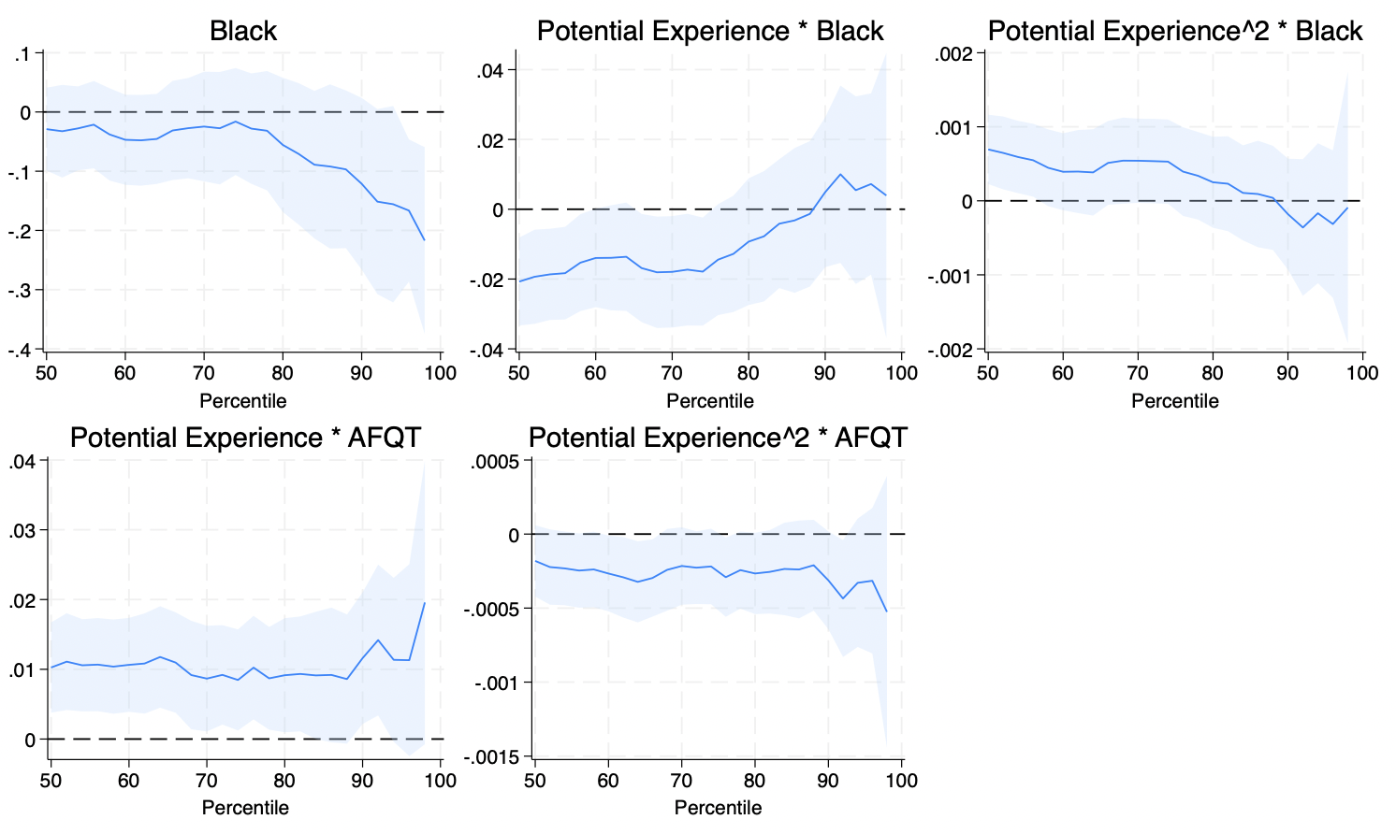
Coefficients for all quantiles – preferred specification

Slide 16
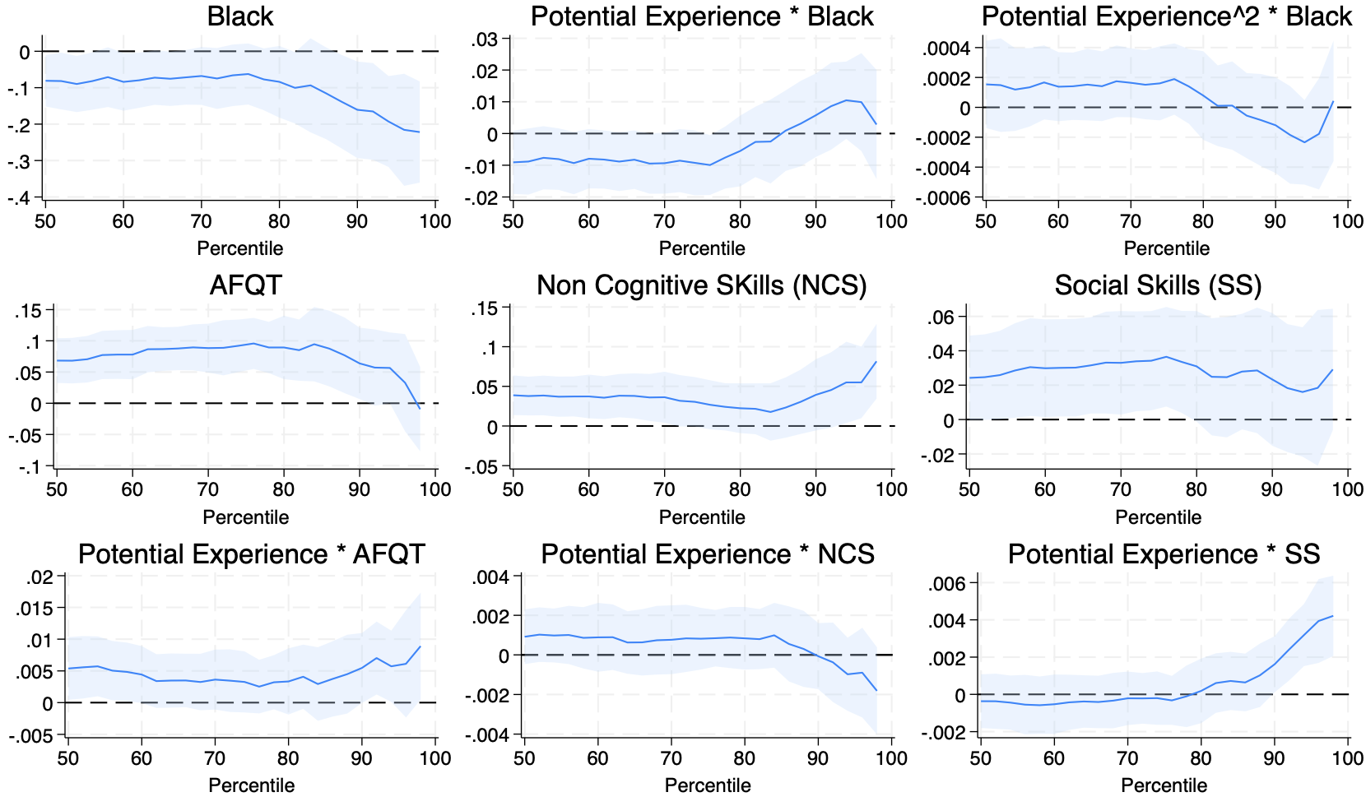
Cool additional finding

Slide 17
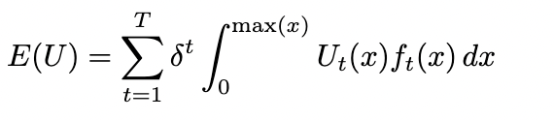
Potential venues for future research
Get a similar age-wage profile analysis for college graduates
Create a model of the choice of going to college
Get a distribution of wages at each age, or get a distribution of age-wage profiles
Get a utility function with risk aversion
Infer the expected utility of going to college by getting something like:
Find out how different skills affect wage growth at different parts of the career.

